Slide 1

Results of Team 60th St.
Team Members:
Saadat
Nashrah
Manali
Andrew
Soubhagya
Micheal
Amit
Mohammed

Slide 2
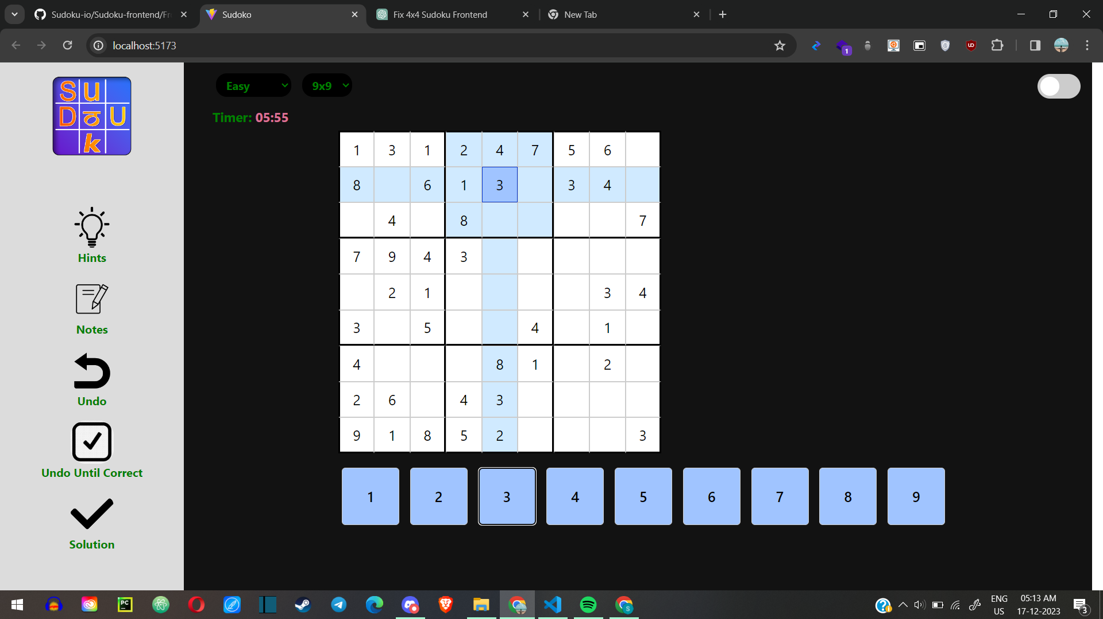
Responsive UI:
Each controller

Slide 3
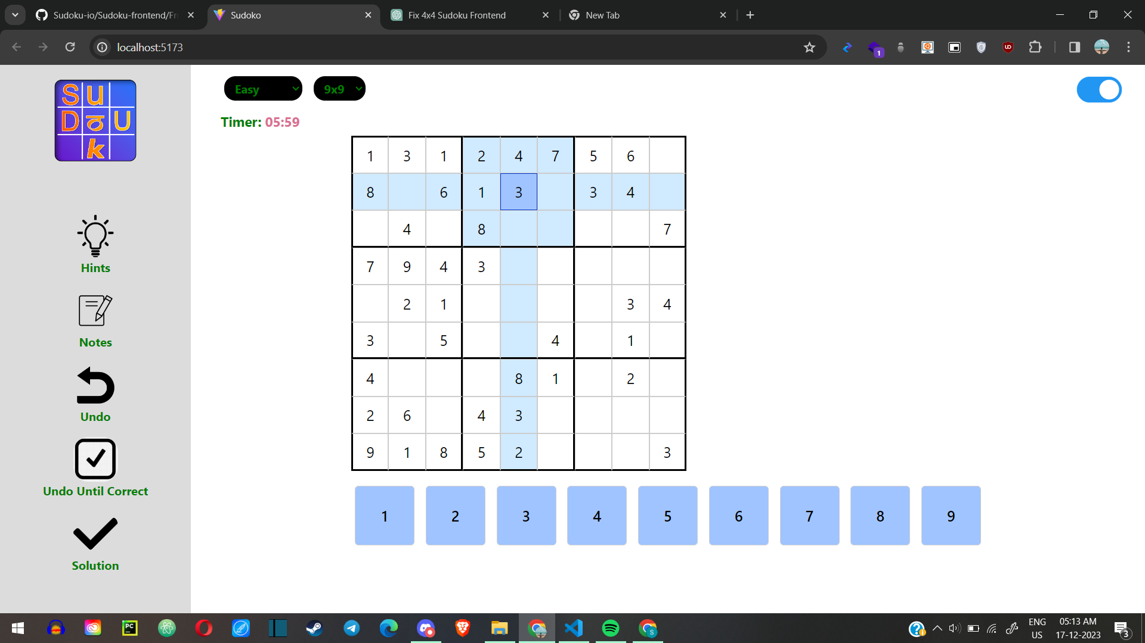

Slide 4
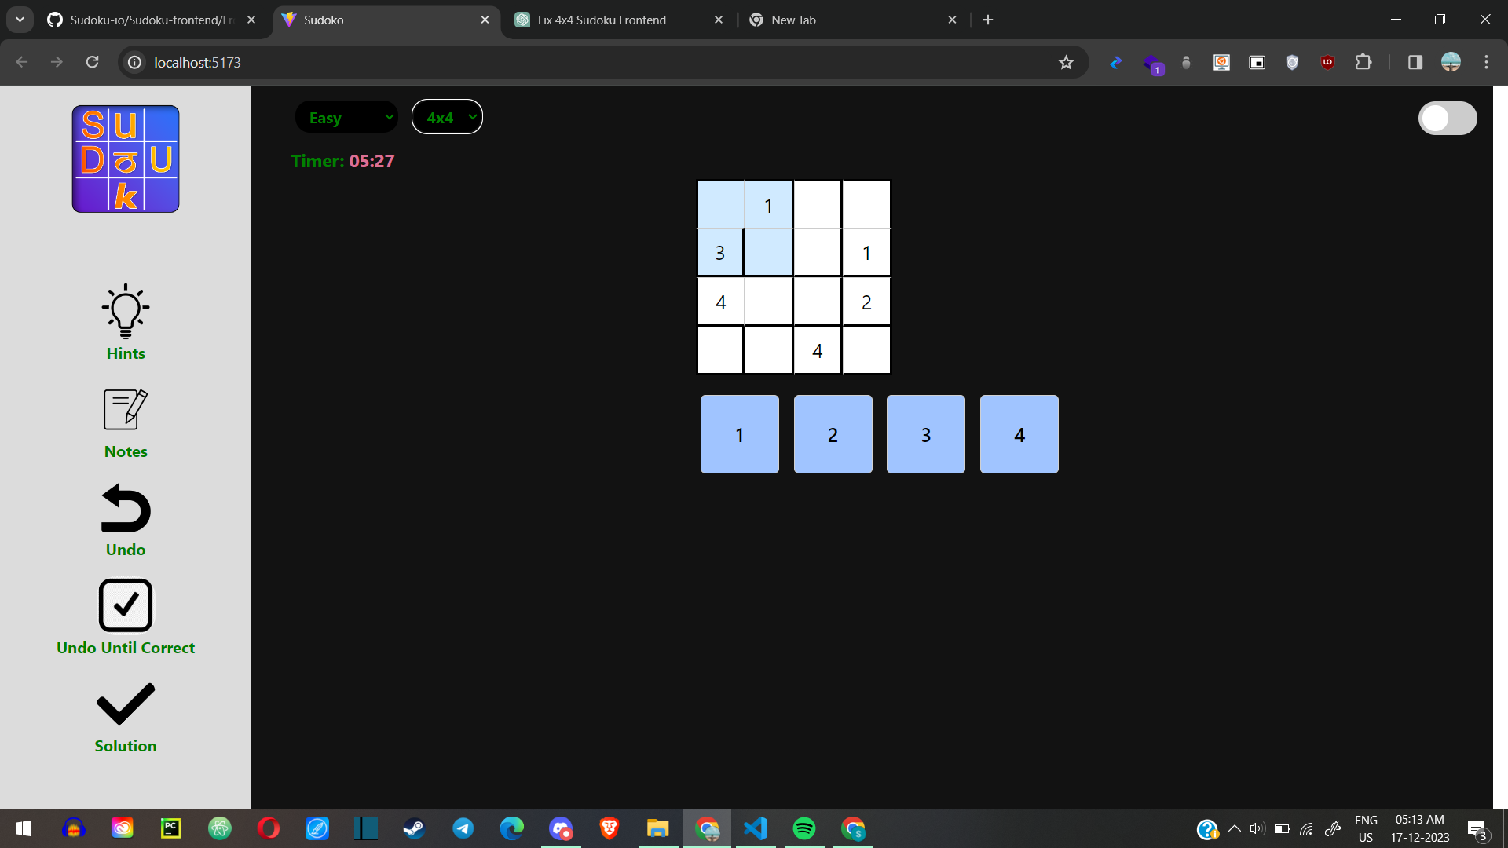
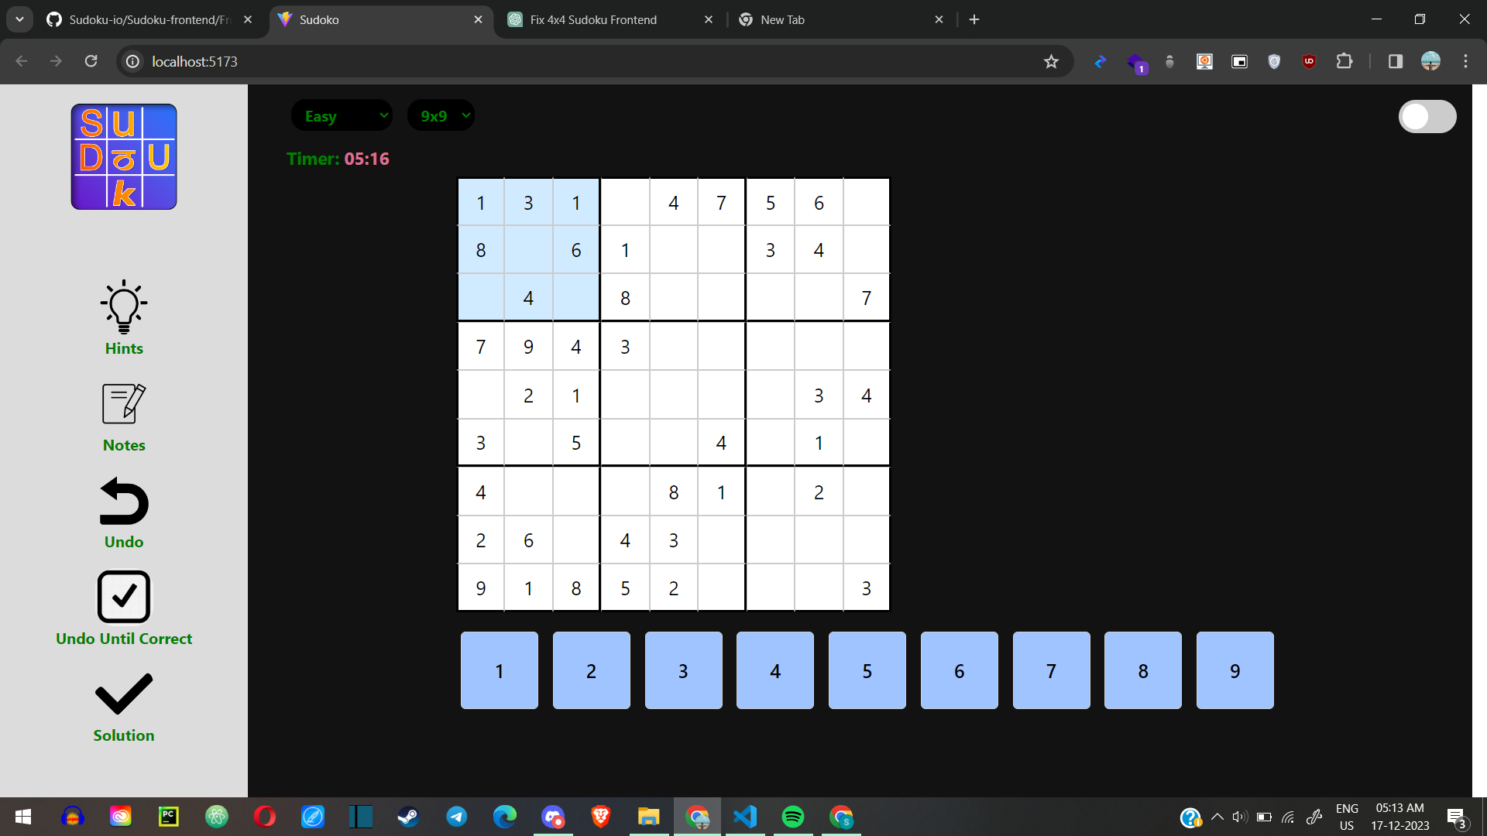


Slide 5


Slide 6
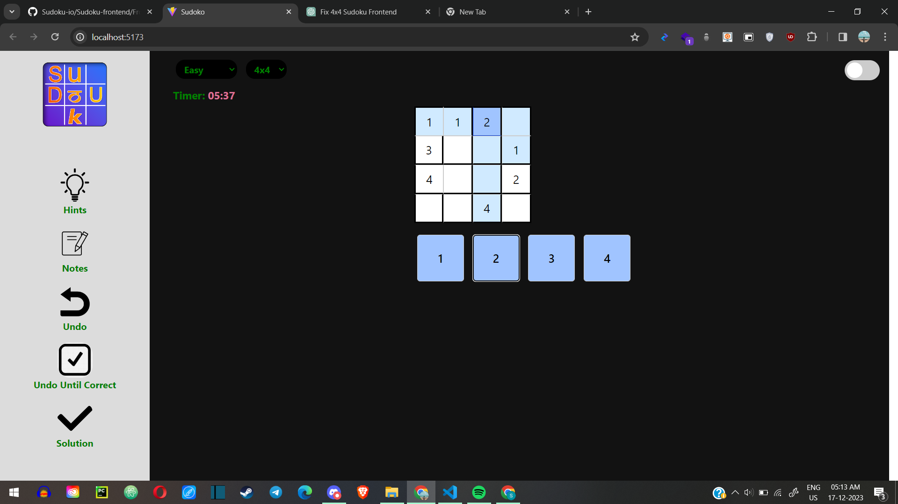

Slide 7
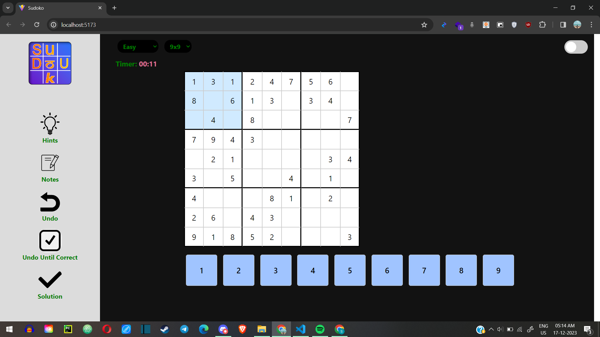

Slide 8
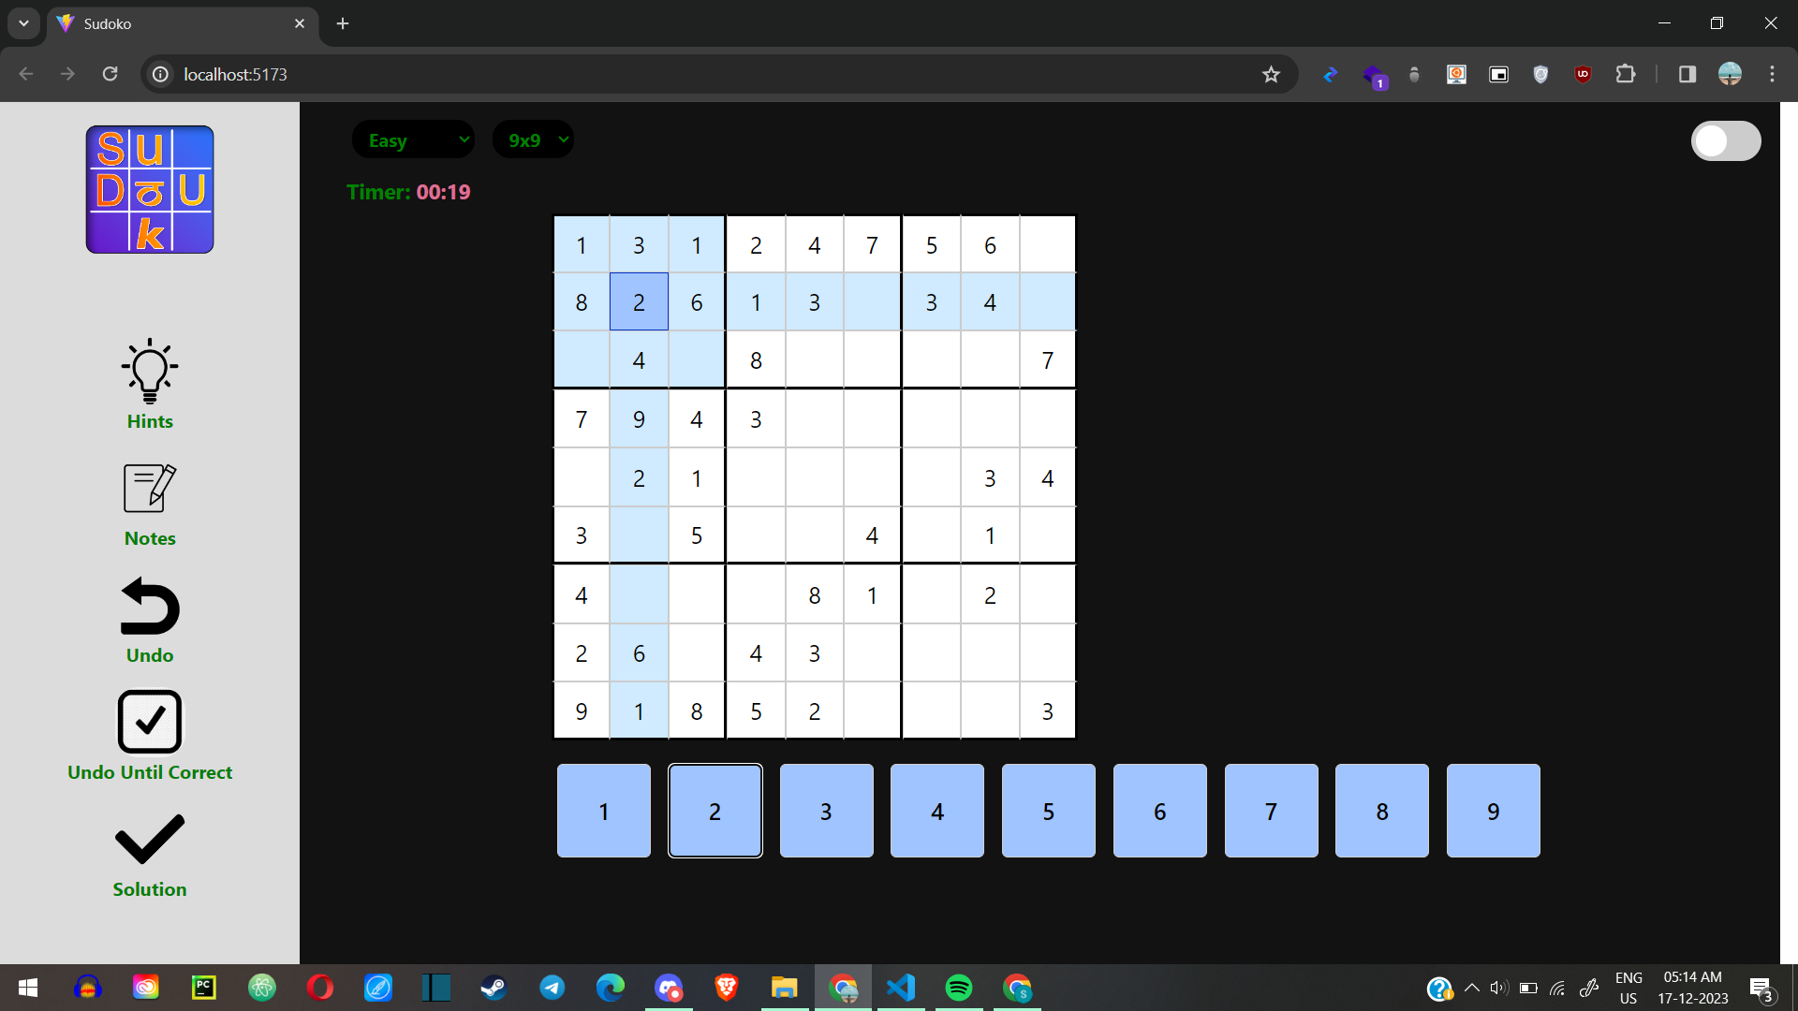

Slide 9


Slide 10


Slide 11


Slide 12
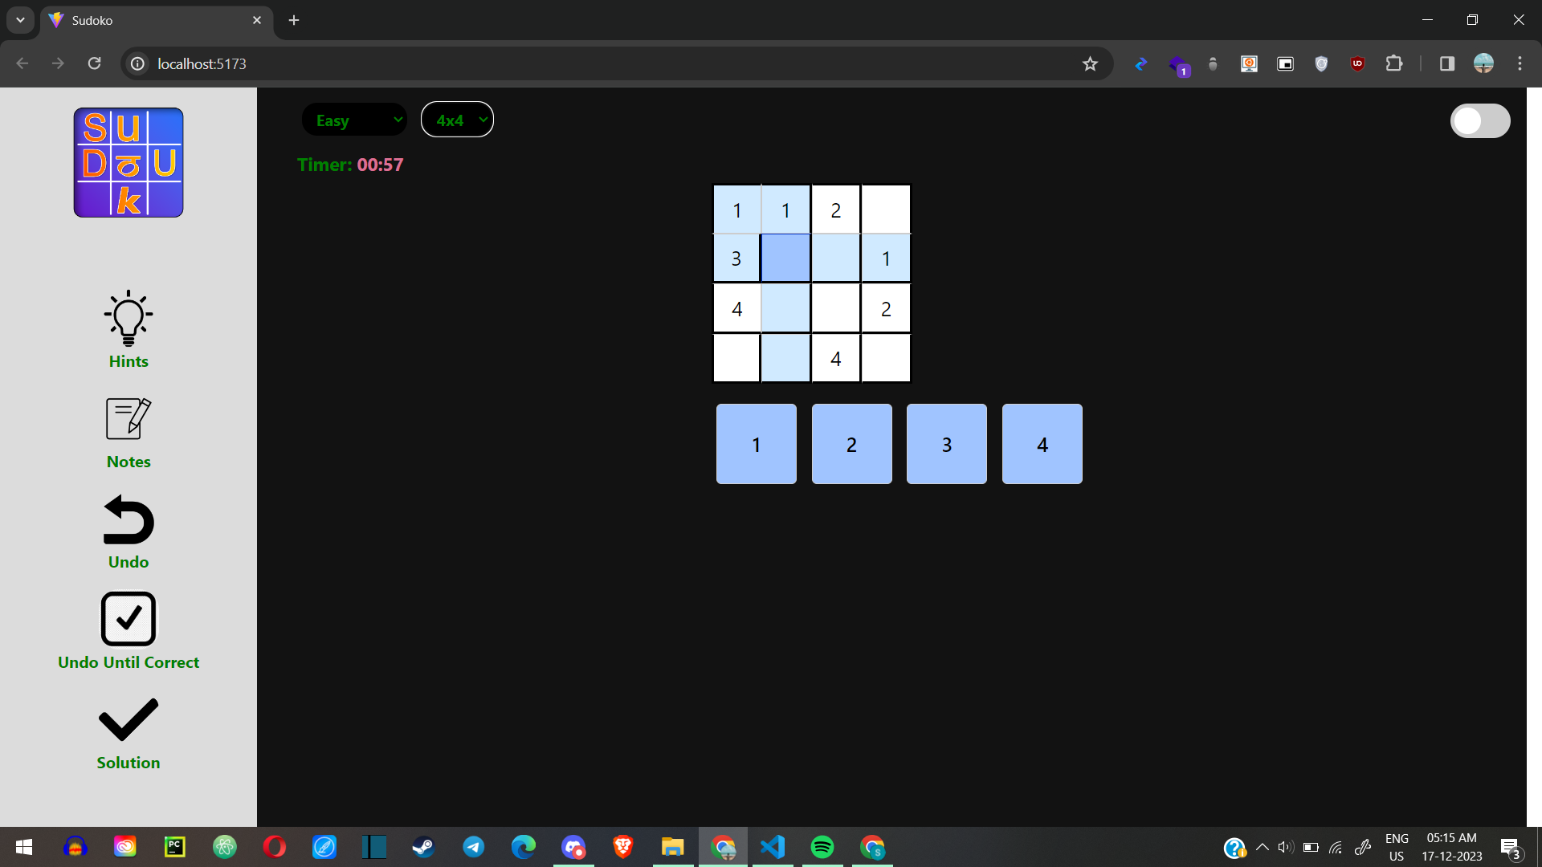

Slide 13


Slide 14
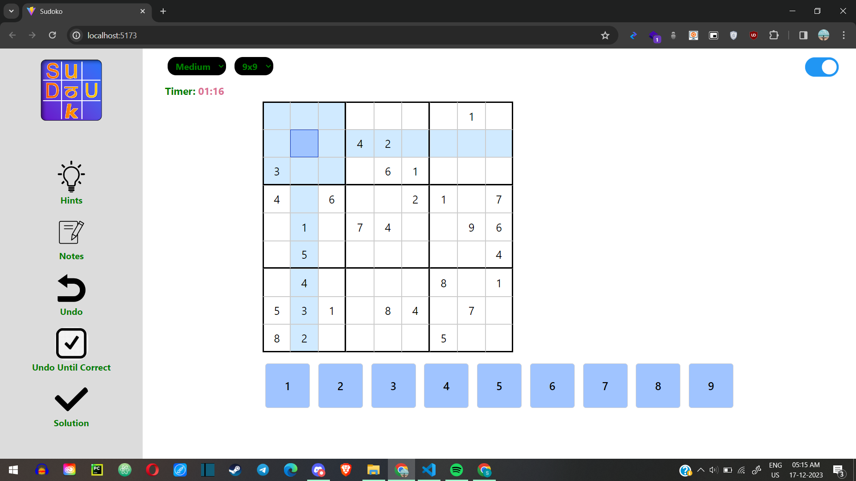

Slide 15
